Slide 1
Azure Storage

Slide 2
Introduction
Azure is cloud storage that allows you to have anywhere and anytime access as long as you have internet connectivity.
Azure Storage is massively scalable and support the big data scenarios required by scientific, financial analysis, and media applications.
Wherever your needs fall, you pay only for the data you're storing.

Slide 3
Azure Storage is elastic, so you can design applications for a large global audience, and scale those applications as needed.
Azure Storage uses an auto-partitioning system that automatically load-balances your data based on traffic.
Azure Storage is accessible from anywhere in the world, from any type of application, whether it's running in the cloud, on the desktop, on an on-premises server, or on a mobile or tablet device.

Slide 4
You can use Azure Storage in mobile scenarios where the application stores a subset of data on the device and synchronizes it.
Azure Storage supports clients using a diverse set of operating systems (including Windows and Linux) and a variety of programming languages (including .NET, Java and C++) for convenient development.
Azure Storage also exposes data resources via simple REST APIs, which are available to any client capable of sending and receiving data via HTTP/HTTPS.

Slide 5
Storage Services
The Azure Storage services are Blob storage, Table storage, Queue storage, and File storage:
Blob storage stores file data. A blob can be any type of text or binary data, such as a document, media file, or application installer.
Table storage stores structured datasets. Table storage is a NoSQL key-attribute data store, which allows for rapid development and fast access to large quantities of data.
Queue storage provides reliable messaging for workflow processing and for communication between components of cloud services.
File storage offers shared storage for legacy applications using the standard SMB 2.1 protocol. Azure virtual machines and cloud services can share file data across application components via mounted shares, and on-premise applications can access file data in a share via the File service REST API.

Slide 6
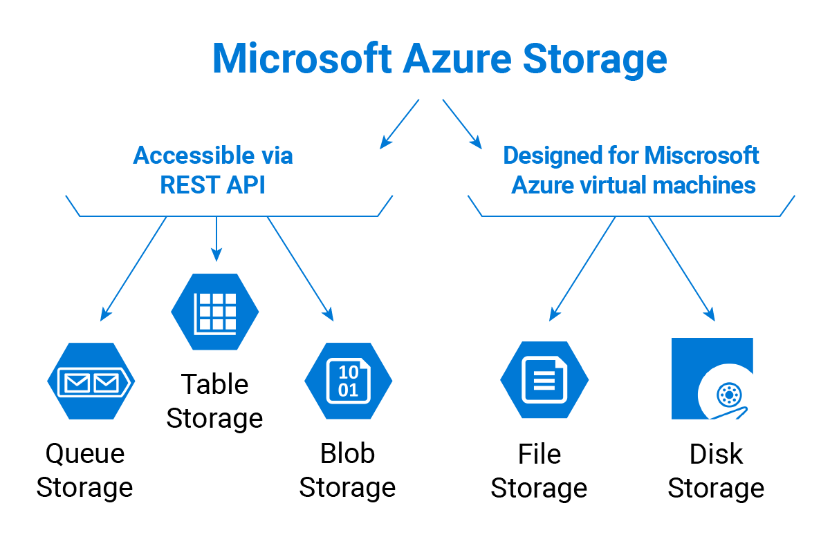

Slide 7
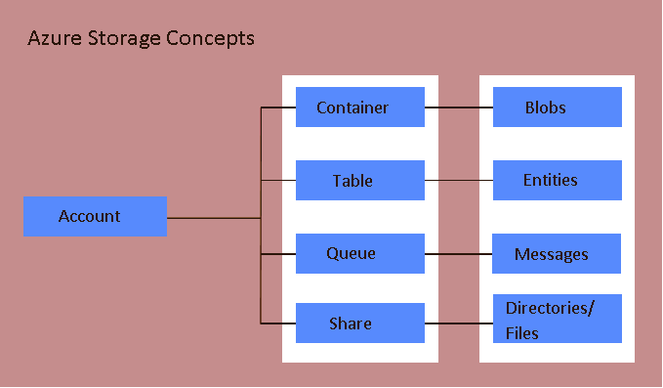

Slide 8
Blob Storage
For users with large amounts of unstructured data to store in the cloud, Blob storage offers a cost-effective and scalable solution.
You can use Blob storage to store content such as:
Data sharing- Documents, photos, videos, music, blogs etc. Simple REST Interface for putting, getting or deleting blobs. Backups of files, computers, databases, and devices.
Configuration data for cloud applications.
Big data, such as logs and other large datasets.

Slide 9
Every blob is organized into a container. Containers also provide a useful way to assign security policies to groups of objects.
A storage account can contain any number of containers, and a container can contain any number of blobs, up to the 500 TB capacity limit of the storage account.
Blob storage offers two types of blobs, block blobs and page blobs (disks). Block blobs are optimized for streaming and storing cloud objects, and are a good choice for storing documents, media files, backups etc.
Page blobs are optimized for representing IaaS disks and supporting random writes, and may be up to 1 TB in size. An Azure virtual machine network attached IaaS disk is a VHD stored as a page blob.

Slide 10
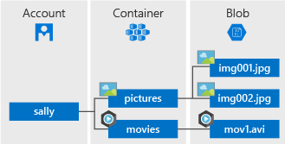

Slide 11
Disk Storage
When you create a Windows Azure Virtual Machine, the platform will attach at least one disk to the VM for your operating system disk.
As you write to the disk in the VM, the changes to the disk will be made to the page blob inside storage.
Unlike for drives, the code that communicates with storage on behalf of your disk is not within your VM, so doing IO to the disk will not cause network activity in the VM, although it will cause network activity on the physical node.
The following diagram shows how the driver runs in the host operating system, and the VM communicates through the disk interface to the driver, which then communicates through the host network adapter to storage.

Slide 12
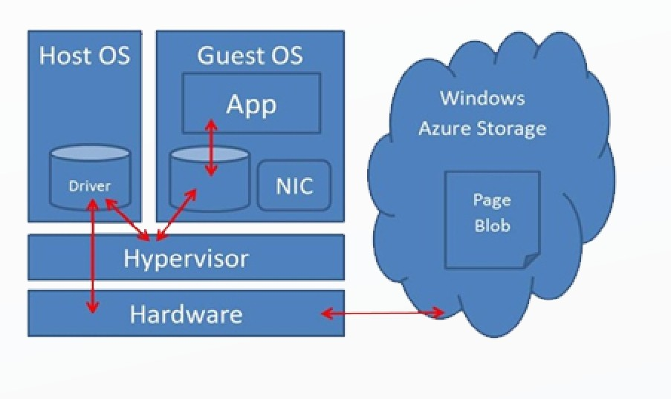

Slide 13
Table Storage
Table storage offers highly available, massively scalable storage, so that your application can automatically scale to meet user demand.
Table storage is Microsoft's NoSQL key/attribute store it has a schemaless design, making it different from traditional relational databases.
Table storage is easy to use, so developers can create applications quickly. Access to data is fast and cost-effective for all kinds of applications.
Table storage is typically significantly lower in cost than traditional SQL for similar volumes of data.
Table storage is a key-attribute store, meaning that every value in a table is stored with a typed property name. The property name can be used for filtering and specifying selection criteria.

Slide 14
Since Table storage is schema less, two entities in the same table can contain different collections of properties, and those properties can be of different types.
You can use Table storage to store flexible datasets, such as user data for web applications, address books, device information, and any other type of metadata that your service requires.
You can store any number of entities in a table, and a storage account may contain any number of tables, up to the capacity limit of the storage account.
Like Blobs and Queues, developers can manage and access Table Storage using standard REST protocols, however Table Storage also supports a subset of the OData protocol, simplifying advanced querying capabilities and enabling both JSON and AtomPub (XML based) formats.

Slide 15
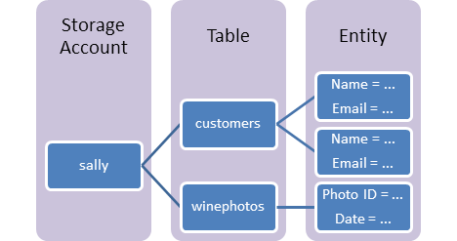

Slide 16
File Storage
File storage offers cloud-based file shares, so that you can migrate legacy applications to Azure quickly and without costly rewrites.
Applications running in Azure virtual machines or cloud services can mount a File storage share to access file data, just as a desktop application would mount a typical SMB share.
Any number of application components can mount and access the File storage share simultaneously.
Since a File storage share is a standard SMB 2.1 file share, applications running in Azure can access data in the share via file sytem I/O APIs.
Developers can therefore leverage their existing code and skills to migrate existing applications.
IT Pros can use PowerShell cmdlets to create, mount, and manage File storage shares as part of the administration of Azure applications.

Slide 17
Like the other Azure storage services, File storage exposes a REST API for accessing data in a share. On-premise applications can call the File storage REST API to access data in a file share.
Note that mounting a file share is only possible for applications running in Azure; an on-premise application may only access the file share via the REST API.
Distributed applications can also use File storage to store and share useful application data and development and testing tools.
For example, an application may store configuration files and diagnostic data such as logs, metrics, and crash dumps in a File storage share so that they are available to multiple virtual machines or roles.
Developers and administrators can store utilities that they need to build or manage an application in a File storage share that is available to all components, rather than installing them on every virtual machine or role instance.

Slide 18
Queue storage
Queue storage provides a reliable messaging solution for asynchronous communication between application components, whether they are running in the cloud, on the desktop, on an on-premises server, or on a mobile device.
Queue storage also supports managing asynchronous tasks and building process workflows.
A storage account can contain any number of queues.
A queue can contain any number of messages, up to the capacity limit of the storage account. Individual messages may be up to 64 KB in size

Slide 19
